Slide 1


Deirdre Maguire
Community Development Officer
1st November 2022
Thinking outside the Tick Box
Registered Charity: 1149181

Slide 2

Zebra Access
Zebra Access CIO is a Deaf- led charity based in Wolverhampton covering the Black Country and surrounding areas.
We provide services and support to Deaf, Deaf Blind and Hard of Hearing people with thanks to The National Lottery Community Fund. Services includes Employment Services, English/Maths tutorials, Advocacy, Community Development, BSL/Deaf Awareness, drop-in sessions dealing with a range of queries, complaints, form filling, and many more.
We aim to provide Deaf role models, enabling Deaf, Deaf Blind and Hard of Hearing people to have self belief and confidence to achieve their aspirations by breaking down barriers. We provide services to support Deaf, Deaf Blind and Hard of Hearing individuals along with a variety of events, clubs and activities. We also deliver Deaf Awareness and BSL training to organisations and individuals who work with Deaf, Deaf Blind and Hard of Hearing communities and individuals.

Slide 3
Zebra Access Services
Advocacy
  Drop-in sessions
  1 to 1 appointments (including home visits etc)
  Video call access
BSL/Deaf Awareness Training
Community Development
Well-Being
  Coffee mornings
  Trips
  Workshops
  1 to 1 support
  Group sessions
  Be-friending
Employment
  Holistic Employment support (including in work support i.e. ATW)
  English & Maths tutorials

Slide 4
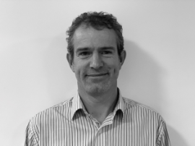
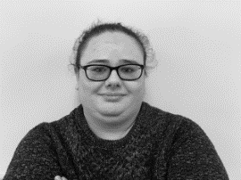
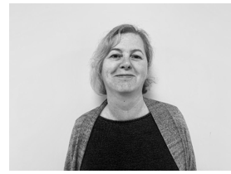
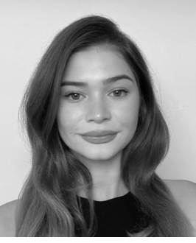
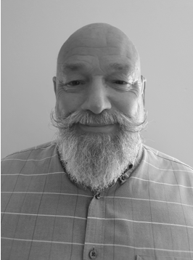
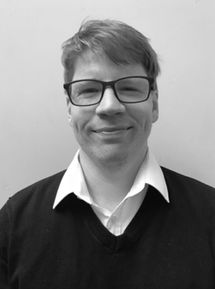
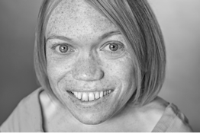
The Zebra Access team
Chris Beech
Project Development
Manager
Deirdre Maguire
Community Development
Officer
Dawn Lynch
BSL & Deaf Awareness Tutor
Ella Gadsby
Wellbeing Officer
Bob Marsh
Fundraising Officer
Trent Szilva-Beasley
Advocacy /IAG Officer
Jo Barber
Social Media Officer

Slide 5
Who Am I?
Deirdre
Deaf family
One BA (hons) degree
Two Post graduate degrees
Specialist area- Deaf adult education
I work as a Community Development Officer for Zebra Access

Slide 6
Community Development- what is it?
Community Development is vital to enable growth and change for the communities within the Black Country.
Community Development seeks to empower individuals and groups of Deaf, DeafBlind and Hard of Hearing people with the skills they need to effect change within their communities.
I also support other services at Zebra Access to ensure all our communities have access to all services and a full understanding of resources provided. Additionally, I work alongside professional bodies to improve the accessibility for Deaf, DeafBlind and Hard of Hearing people.

Slide 7
Facts about Deafness
11 million people in the UK have some form of deafness
There are around 340,000 deafblind people in UK
1 in 6 will become deaf/hard of hearing
Deafness is 2nd most common disability in UK
Approx. 90% deaf children are born to hearing parents
Deaf people are twice more likely to develop mental health illnesses than their hearing peers but least likely to access support
As of April 2022, BSL is one of UK’s main languages along with
English, Scots Gaelic and Welsh.

Slide 8
Barriers Deaf People/Communities face
Bilingual language are more often not offered as early language development leading to late language acquisition. Why?
Society’s attitude on focusing on fixing the ‘hearing and the speech’
Access to mainstream services- Deaf people are often an afterthought
Just providing communication access is not a solution- accessibility is more than just that
Not being included in daily conversations, news, information, gossip etc
Inaccessible services i.e. GP, Hospitals, Audiology, Councils, general retailers etc
ABLEISM and AUDISM

Slide 9
Solutions
Don’t place burden of communication on us
Learn to sign!
Make society more accessible with small steps-
  Captioning your social media content, it not just for deaf people but also for people who use English as a second language, and it improves your literacy skills!
  Visual information
  Alternative contact methods
Ensure budget for interpreters, speech to text, BSL/Deaf consultants, BSL courses are factored in your funding, grant, event, or training applications.
When planning- bring a Deaf person on board from start- not at the end.
Include Deaf people on your forums, boards and LISTEN to their lived experiences

Slide 10






Follow us @
www.zebra-access.com
zebra_access
ZebraAccess
Zebra Access
deirdre@zebra-access.com
Zebra Access

Slide 11
www.zebra-access.com

